Slide 1




Tashkent - 2025

Slide 2


COMPANY PROFILE
COMPANY HAS BEEN WORKING SINCE 2019
BAKHT provides consulting services to attract local and international investors into profitable projects;
Trainings, expert consulting and advisory services in finance, Islamic banking and finance ;

Slide 3







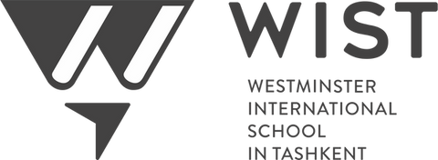




LOCAL PARTNERS

Slide 4










INTERNATIONAL
PARTNERS
UAE, CANADA, SINGAPORE, USA, SWITZERLAND
PARTNERSHIPS WITH

Slide 5


PROFESSIONAL TEAM
ISLAMIC BANKING AND FINANCE, FUNDRAISING, LEGAL, TAXATION,

Slide 6



FACILITATED FINANCING USD 12 MLN ATTRACTED USD 6 MLN FOR TERM DEPOSIT
Financing leasing deals for Telecommunication industry and for FMCG industry
RAISED OVER USD 6 MLN DEBT FINANCING
USA market VC debt for home services busienss, Financial leasing deal for telecommunication industry
INVESTMENT BACKGROUND
OBTAINED USD 105 K GRANT FROM
USAID, EUR 20 K GRANT FROM EBRD
For purchasing equipment for processing and drying of fruits, for introducing certification standards of HACCP, ISO 22000

Slide 7



USA BASED
On-demand service - Prop- tech Raised USD 5 Mln VC debt financing prior to A- Series with USD 10 Mln
UZBEKISTAN BASED
Training conducted in Islamic Banking and Finance for bankers, leasing providers, insurance companies
EXISTING PROJECTS UAE BASED
Energy storage Raising USD 3 MLn - Seed

Slide 8


SERVICES OFFERED
Training in Islamic Banking and Finance, Pre-investment preparation: Pitch Deck, Teaser, List of Investors Audit services to find out current investment status of company
INVESTOR SOURCING
Search and sourcing of investors in international markets: Email, Phone communication, pitching, Data Room, Story and script for investors, FAQ Working out investment proposal for interested investors
ADDITIONAL SERVICES
Negotiation of terms with foreign partners and investors Presentation of company and its products to interested investors Working out business plans, feasibility studies

Slide 9


ADDRESS
Tashkent city, Mustaqillik street 88a
CONTACT INFORMATION
PHONE NUMBER
+ 998 91 192 23 22
EMAIL AND WEBSITE
info@bakht.uz www.bakht.uz

Slide 10
WELCOME WORD
Bismillah-ir-Rahman-ir-Rahim.
Ladies and Gentlemen,
Assalamu Alaikum wa Rahmatullahi wa Barakatuh,
It is a pleasure to be with you today to share some insights on a subject with growing relevance:
“Funding Sources of Islamic Finance Providers”—and how we can leverage them to foster inclusive and ethical economic growth.

Slide 11
Islamic finance represents not just a faith-based financial system, but a value-centered engine for responsible investing and economic participation. It emphasizes risk-sharing, fairness, and investment in the real economy.
Today, we will examine:
Key funding sources for Islamic finance providers
Practical examples in Central Asia and globally
How entrepreneurs, investors, and financial institutions can tap into this ecosystem

Slide 12
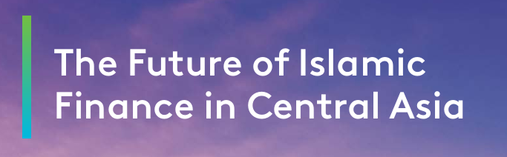

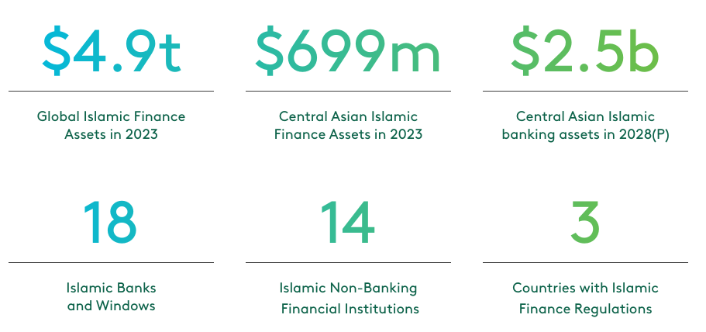

Slide 13
This is the capital injected by founders, private investors, sovereign wealth funds, and institutional investors.
Zaman Bank (Kazakhstan) – Funded by local investors including First Heartland Securities
Uzbek Leasing International – Equity contributions from local and foreign stakeholders
Taiba leasing (Uzbekistan) - Equity contributions from local and foreign stakeholders .
Alif Bank (Tajikistan) – Initially bootstrapped by equity from investors.
Shareholders’ Equity

Slide 14
Central Asian countries still make only a modest contribution to the global Islamic finance industry, with reported Islamic finance assets of USD 699 million in 2023, or 0.01% of total global Islamic finance assets.
According to the Islamic Finance Development Report 2024, Kazakhstan ranked 19 globally in the level of Islamic Finance development in 2024 The Kyrgyz Republic 32, Uzbekistan 63, and Tajikistan 82, respectively, while Turkmenistan ranking 111.
Global GDP 2024 - $110 Trln
Central Asian GDP 2024 - $500Bln (0,45%)
Global Islamic assets - $5,4 Trln
Central Asian Islamic finance assets - $0,7Bln (0,00013%)
Opportunity to grow at least 500 times

Slide 15
These are non-guaranteed, profit-sharing investment deposits.
Al Safi Bank and TAYYAB (Kazakhstan)
IMANUM and Hayot Bank (Uzbekistan)
(Kyrgyzstan) crowdfunding + savings model
Alif Bank (Tadjikistan)
Investment Accounts (Mudarabah & Wakalah)

Slide 16
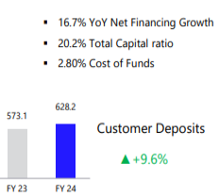
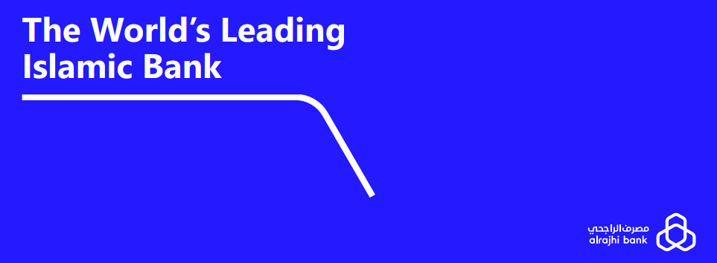
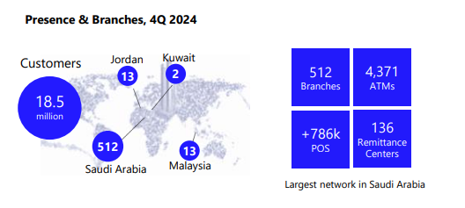

Slide 17
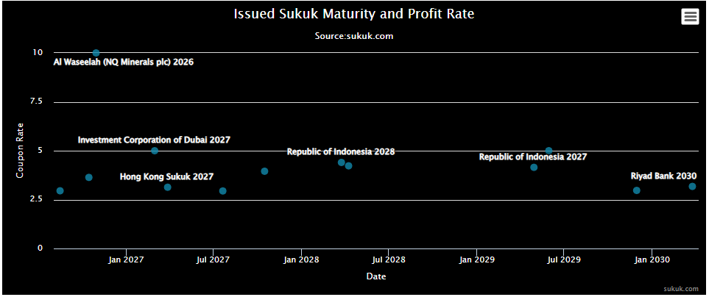
Sukuk allows providers to raise capital by selling ownership in assets, not debt.
ICD Raises KZT 2 billion in Kazakh Tenge Sukuk Debut
Kazakhstan Sukuk Framework – National Bank building a regulatory base
Uzbekistan’s Ministry of Finance – Studying sovereign sukuk pilot
Sukuk – Islamic Capital Market Instrument

Slide 18
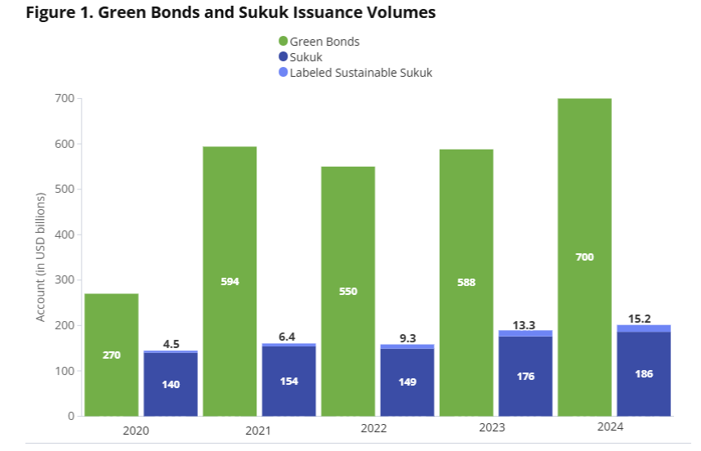
There were many notable international transactions in 2024, such as Indonesia’s 30-year green sukuk, a $5 billion issue from Saudi Arabia, and a $2.5 billion sustainability sukuk issued by the Islamic Development Bank.

Slide 19
These include short-term liquidity tools and Shariah-compliant business units inside conventional banks.
Microcreditbank (Uzbekistan) – Islamic window pilot
Astana International Exchange – Working on Islamic repo tools
.
Uzbek Leasing Islamic Window
Islamic Windows & Interbank Liquidity Platforms

Slide 20

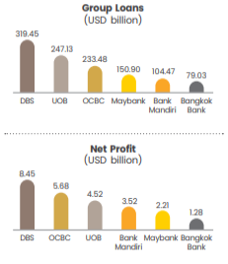
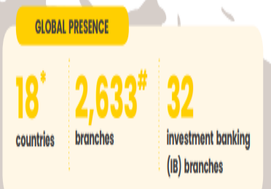
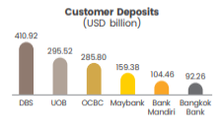

Slide 21
These include multilateral institutions, government programs, and philanthropic endowments.
Islamic Development Bank (IsDB) – Over $2 billion committed to Central Asia
ICD (Private Sector Arm of IsDB) – Invested in over 10 institutions in the region
IsDB-Waqf Fund – Tajikistan and Uzbekistan partnership
Institutional & Development Finance – Catalysts for Growth

Slide 22


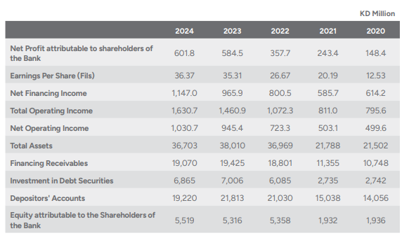

Slide 23
These examples prove that Islamic finance is not theoretical—it is practical, growing, and global. The challenge is not lack of capital—but the lack of awareness and alignment.
Let us:
Educate entrepreneurs about equity, leasing, and risk-sharing tools
Encourage investors to explore halal, high-impact opportunities
Push financial institutions to innovate Islamic offerings that serve real needs
Together, we can build a finance system rooted in values, inclusive in nature, and global in reach.
Thank you.
Wassalamu Alaikum wa Rahmatullahi wa Barakatuh.

